Slide 1
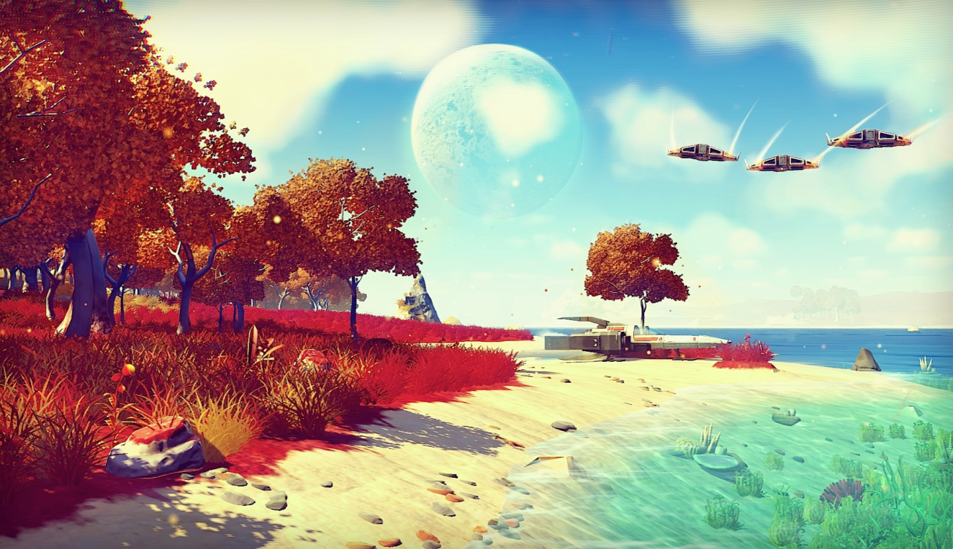
Game Technology
Lecture 10 – 19.12.2014
Procedural Content Generation
Dr.-Ing. Florian Mehm
Dipl-Inf. Robert Konrad

Slide 2
Preliminary timetable
Lecture No. | Date | Topic
1 | 17.10.2014 | Basic Input & Output
2 | 24.10.2014 | Timing & Basic Game Mechanics
3 | 31.10.2014 | Software Rendering 1
4 | 07.11.2014 | Software Rendering 2
5 | 14.11.2014 | Basic Hardware Rendering
6 | 21.11.2014 | Animations
7 | 28.11.2014 | Physically-based Rendering
8 | 05.12.2014 | Physics 1
9 | 12.12.2014 | Physics 2
10 | 19.12.2014 | Procedural Content Generation
11 | 16.01.2015 | Compression & Streaming
12 | 23.01.2015 | Multiplayer
13 | 30.01.2015 | Audio
14 | 06.02.2015 | Scripting
15 | 13.02.2015 | AI

Slide 3
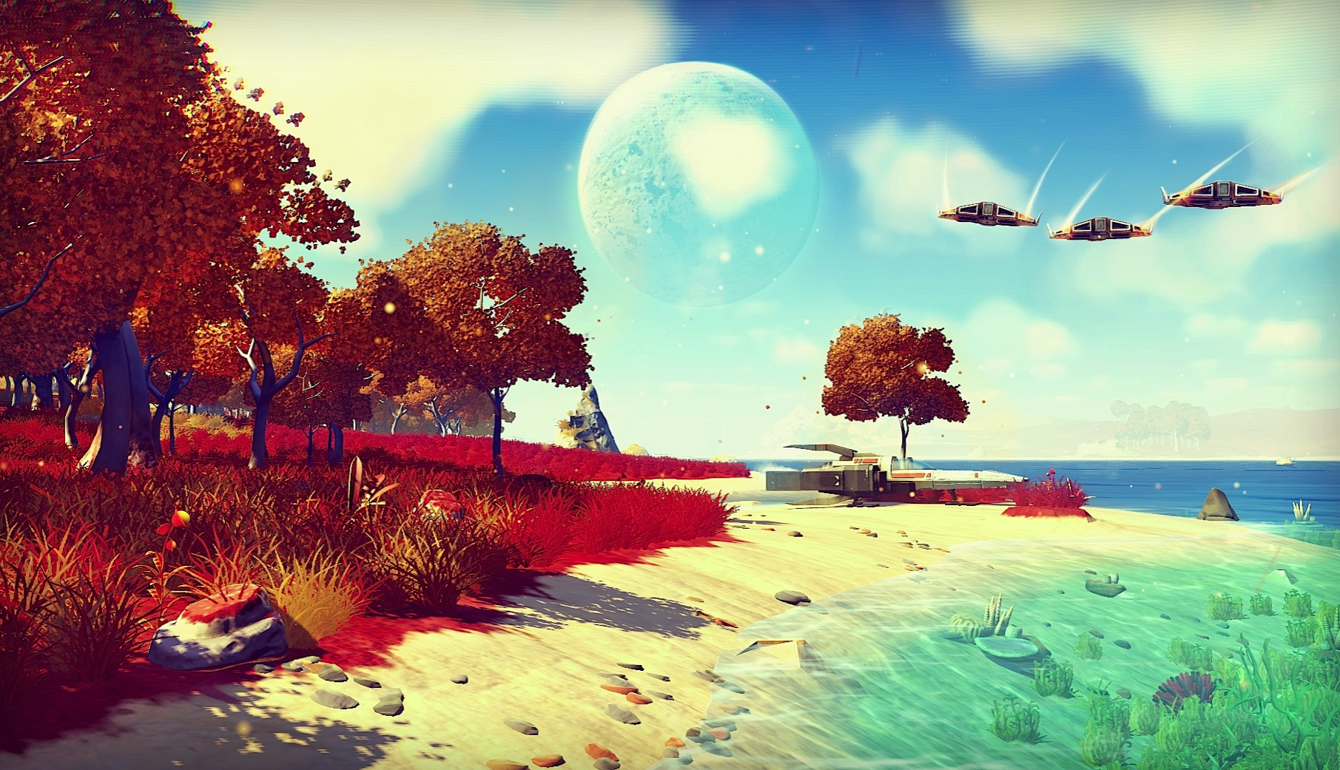
Example: No Man‘s Sky

Slide 4
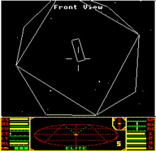
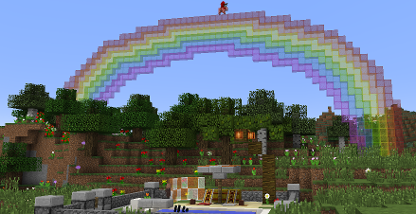
History
Elite
1984
8 galaxies with 256 planets each
Generated galaxies, planets including names and properties
BBC Micro: max. 128 KB Memory, Elite was 52 KB of disk space
Minecraft
Official Release 2011
Generates terrain including placement of settlements, resources, ... Procedurally
Sold for 2.5 billion USD to Microsoft in 2014

Slide 5
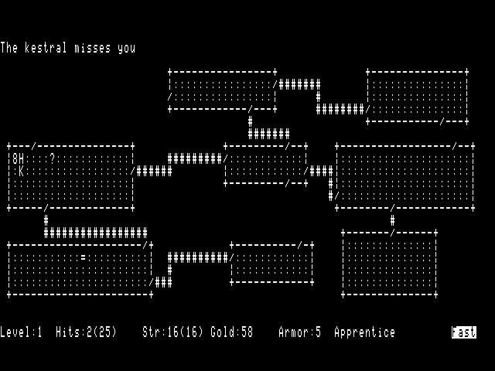
History
Rogue & Roguelikes
Original released in 1980
Generated a new dungeon each time the player went to a new level
Algorithm for constructing the levels
http://kuoi.asui.uidaho.edu/~kamikaze/GameDesign/art07_rogue_dungeon.php

Slide 6
History - Rogue
Divide the map into a grid (Rogue uses 3x3, but any size will work).
Give each grid a flag indicating if it's "connected" or not, and an array of which grid numbers it's connected to.
Pick a random room to start with, and mark it "connected".
While there are unconnected neighbor rooms, connect to one of them, make that the current room, mark it "connected", and repeat.
While there are unconnected rooms, try to connect them to a random connected neighbor (if a room has no connected neighbors yet, just keep cycling, you'll fill out to it eventually).
All rooms are now connected at least once.
Make 0 or more random connections to taste; I find rnd(grid_width) random connections looks good.
Draw the rooms onto the map, and draw a corridor from the center of each room to the center of each connected room, changing wall blocks into corridors. If your rooms fill most or all of the space of the grid, your corridors will very short - just holes in the wall.
Scan the map for corridor squares with 2 bordering walls, 1-2 bordering rooms, and 0-1 bordering corridor, and change those to doors.
Place your stairs up in the first room you chose, and your stairs down in the last room chosen in step 5. This will almost always be a LONG way away.

Slide 7
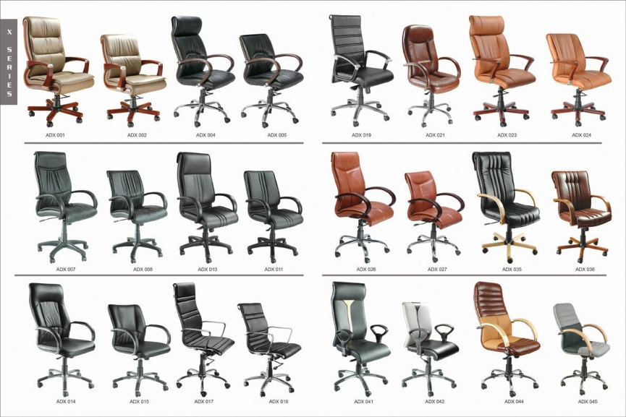
Principles
Structure
Many PCG algorithms can create instances of classes of objects
One type of house, tree, clothing, ...
Recognizable structure in each instance
Structured way of deriving an instance
Randomness
Not a defining characteristic of PCG
But often a central component
Has the advantages of fooling the eye, adding replayability

Slide 8
Classification of Generators
Online versus offline
Online: Every time a new result
Offline: Can be evaluated by an artist/designer
Necessary versus optional
Necessary: The game would not work without PCG
Optional: Background objects, ambient sounds, …
Degree and dimensions of control
How much control is needed?
For whom? Game designer, artist, end user?

Slide 9
Classification of Genres
Generic versus adaptive
Generic: One size fits all
Adaptive: React to players, build better challenges, adjust for play preferences
Stochastic versus deterministic
Stochastic: Variation, Replayability
Deterministic: Can be checked, repeated, the same for each player
„Arse“ galaxy in Elite
Constructive versus Generate-and-test
Constructive: Carry out PCG once
Generate-and-test: Carry out PCG repeatedly
Automatic generation versus mixed authorship
Mixed authorship: Designer changes something – PCG algorithm refines it - …

Slide 10
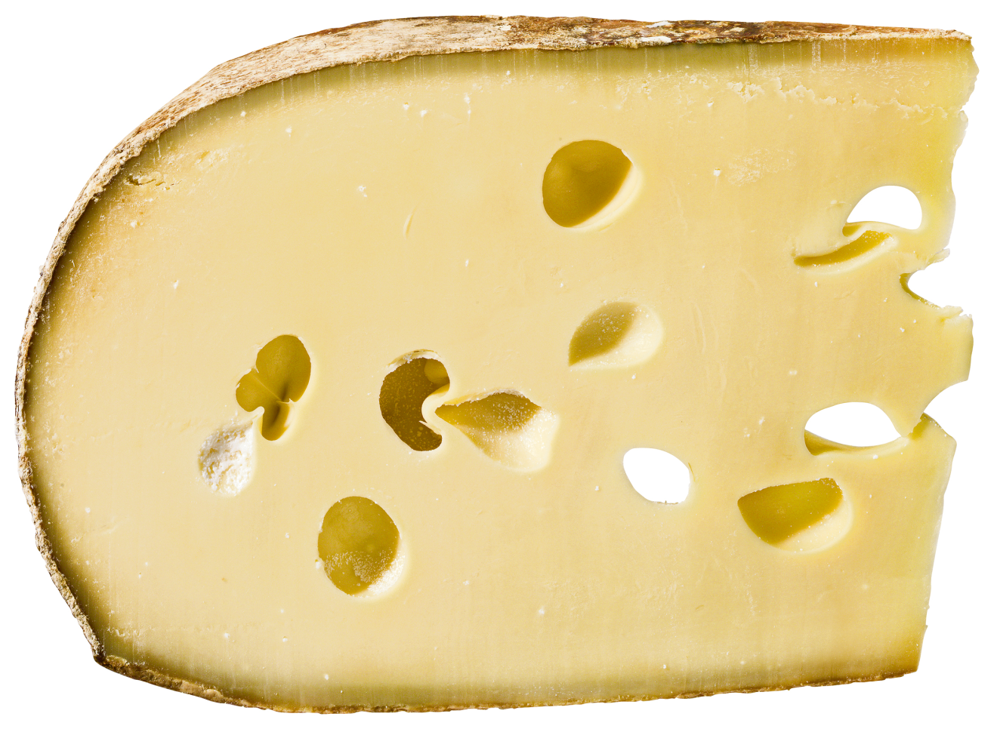
Teleological vs. Ontogenetic

Slide 11
Teleological vs. Ontogenetic
Teleological
Creates an accurate model of the result
PCG is the simulation of realistic processes
Example: A landscape is formed by simulating the process of erosion
Ontogenetic
Observe the properties of the end result
Re-create the result without following the “natural” way to derive it
Example: Forming a landscape using a noise function

Slide 12
Basic Tools
Random Number Generators
Not handled here
Regular Languages, Grammars, Automata
Noise functions
Graph algorithms
Genetic algorithms, heuristics

Slide 13
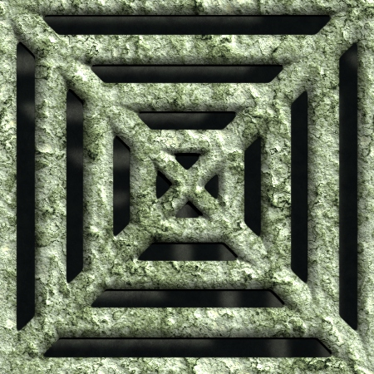
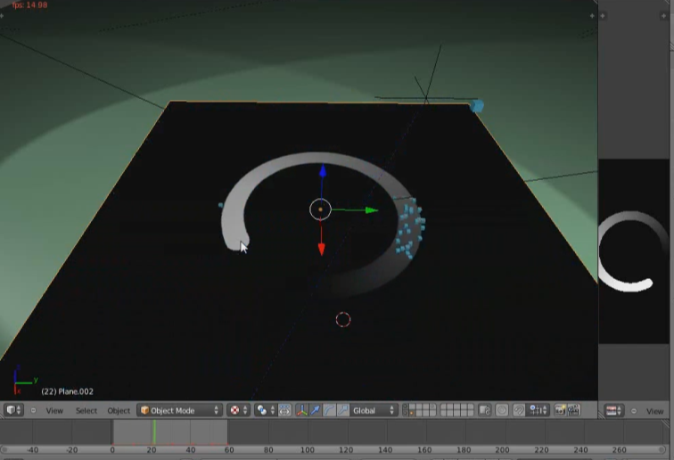
Texture Generation
Generate
Texture
Normal Map
Specular Map
...
Can be used in different systems
Textures for objects
Height maps
Controlling flow or emission of particles
https://www.youtube.com/watch?v=UZGoht2vkzU

Slide 14
Texture Generation
Basic Generators & Image inputs
Provide basic shapes and patterns
Can insert randomness into the process
Also image inputs to use in further steps
Filters
Change the look of the input texture
Enhance, blur, filter, ...
Carry out mathematical operations
Combinations
Combine different textures
Generator
Filter
Combination

Slide 15
Texture Generation Node Networks
Combine different algorithms
Basic Generators have only texture output(s)
Filters and Combiners have
One or more texture inputs
One or more texture outputs
Generator
Filter
Combination
Result
Generator

Slide 16
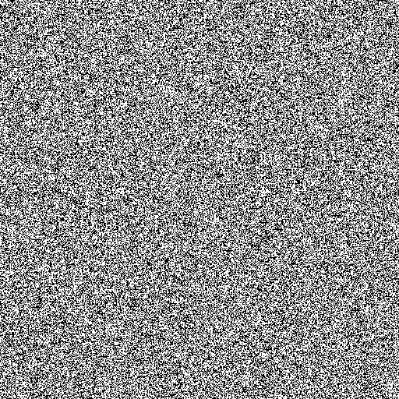



Example of networks - Metal
Noise
Motion
Blur
Overlay
Result
Gradient

Slide 17

Basic Generators
Random
All colors
Grayscale
Patterns
Grids
Dots/Spheres
Jittered patterns
Voronoi Diagram
Random Noise
Perlin Noise

Slide 18
Basic Generators
Random
All colors
Grayscale
Patterns
Grids
Dots/Spheres
Jittered patterns
Voronoi Diagram
Random Noise
Perlin Noise

Slide 19
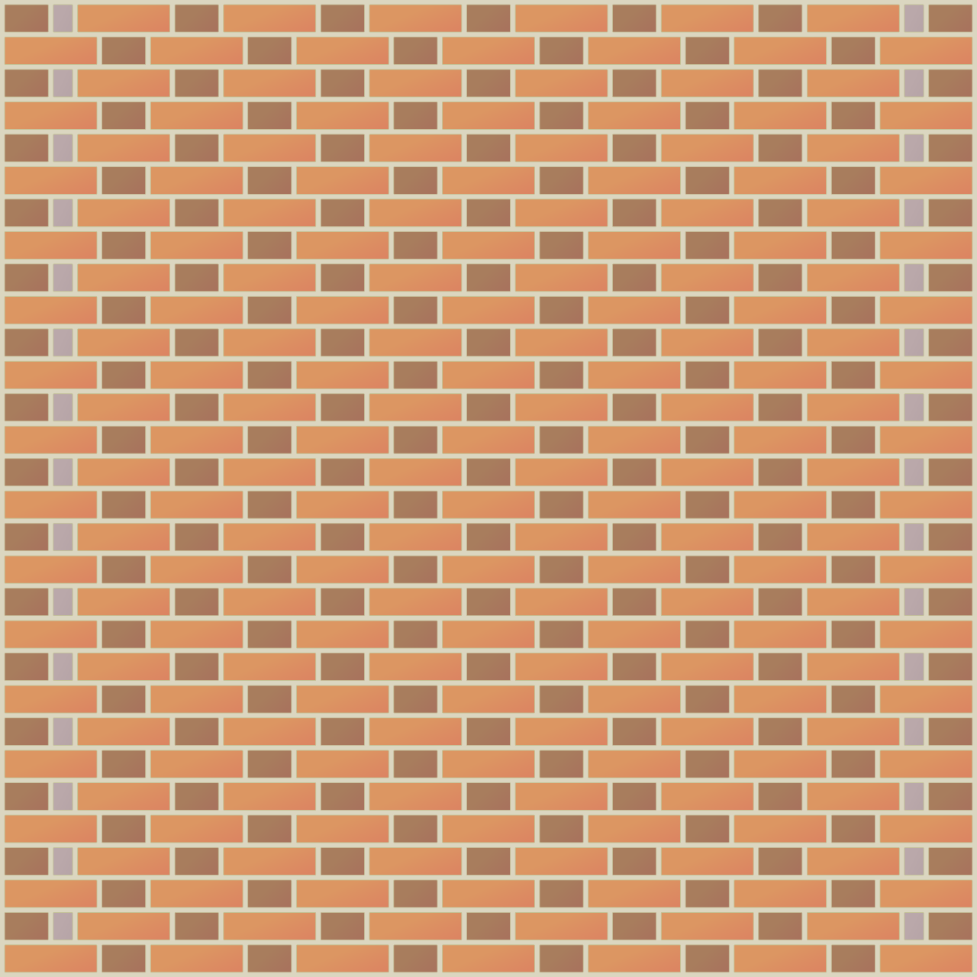
Basic Generators
Random
All colors
Grayscale
Patterns
Grids
Dots/Spheres
Jittered patterns
Voronoi Diagram
Random Noise
Perlin Noise

Slide 20

Basic Generators
Random
All colors
Grayscale
Patterns
Grids
Dots/Spheres
Jittered patterns
Voronoi Diagram
Random Noise
Perlin Noise

Slide 21
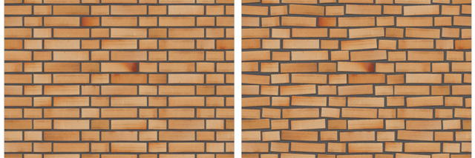
Basic Generators
Random
All colors
Grayscale
Patterns
Grids
Dots/Spheres
Jittered patterns
Voronoi Diagram
Random Noise
Perlin Noise

Slide 22
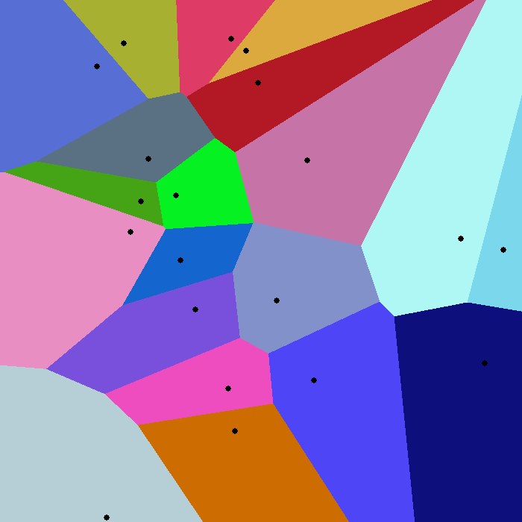
Basic Generators
Random
All colors
Grayscale
Patterns
Grids
Dots/Spheres
Jittered patterns
Voronoi Diagram
Random Noise
Perlin Noise

Slide 23
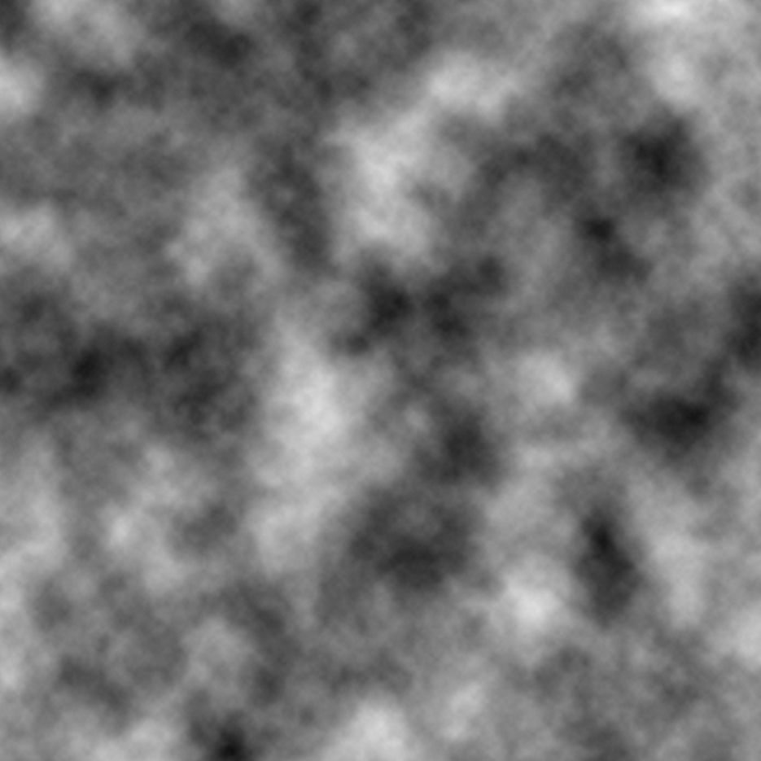
Basic Generators
Random
All colors
Grayscale
Patterns
Grids
Dots/Spheres
Jittered patterns
Voronoi Diagram
Random Noise
Perlin Noise

Slide 24
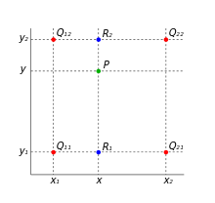
Filters - Basics
Each pixel of the resulting image is based on one or more pixels of the input image
Remember bilinear filtering for texture lookups
We looked up the values of 2x2 pixels to get a value for the final pixel
Filter kernel
Specifies the pixels we need to sample and the weights we sample them with

Slide 25
Box filter
Move a box over the image
New pixel = Sum of original pixels * weights
Iterate over the image and calculate new pixels
Minimal Kernel size: 3x3
Size must be odd numbers (→ central pixel)
In the following slides
Divide by the sum of the values of the kernel → Normalization
Alternatively, floating point numbers could be used?
How to handle edges?
Similar to texture lookup
Extend the image, fill with constant color, …

Slide 26

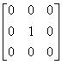

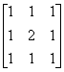
Box filter results
Unfiltered image
Smoothing

Slide 27
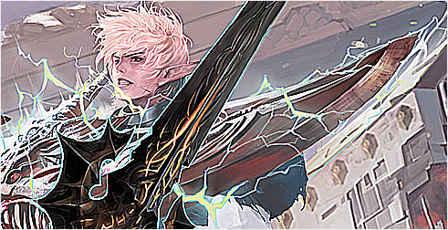
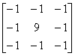
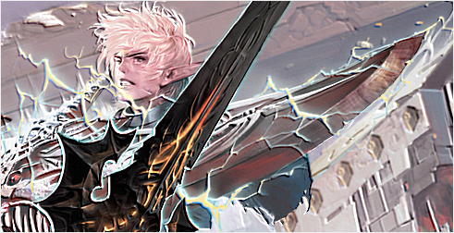
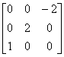
Box filter results
Sharpening
Raised

Slide 28

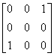
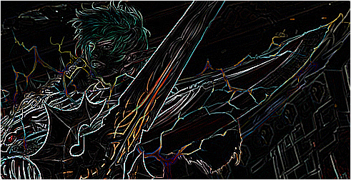
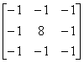
Box filter results
Motion Blur
Edge Detection

Slide 29
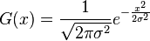
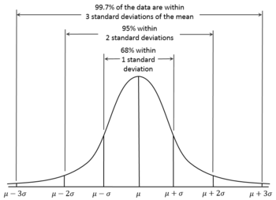
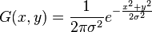
Gaussian Blur
In one dimension
σ is the standard deviation
μ is not in the formula → μ = 0
Calculation of the kernel
In theory, G(x) would never be 0
But in practice, all values further away from 0 than ~3σ will be almost 0
In two dimensions
Product of two Gaussian distributions
Can be separated into a vertical and a horizontal pass (faster)
Carrying out a box blur several times can approximate a Gaussian blur

Slide 30
Gaussian Blur – Example Kernel
0.00000067 0.00002292 0.00019117 0.00038771 0.00019117 0.00002292 0.00000067
0.00002292 0.00078634 0.00655965 0.01330373 0.00655965 0.00078633 0.00002292
0.00019117 0.00655965 0.05472157 0.11098164 0.05472157 0.00655965 0.00019117
0.00038771 0.01330373 0.11098164 0.22508352 0.11098164 0.01330373 0.00038771
0.00019117 0.00655965 0.05472157 0.11098164 0.05472157 0.00655965 0.00019117
0.00002292 0.00078633 0.00655965 0.01330373 0.00655965 0.00078633 0.00002292
0.00000067 0.00002292 0.00019117 0.00038771 0.00019117 0.00002292 0.00000067

Slide 31
Motion Blur
Gaussian Blur works in all directions simultaneously
Motion blur simulates the way a picture would be blurred on a camera‘s sensor
Simple way to approximate it
Use Gaussian Blur only in one direction
If the blur should be rotated: Rotate the image, blur horizontally/vertically, rotate back

Slide 32
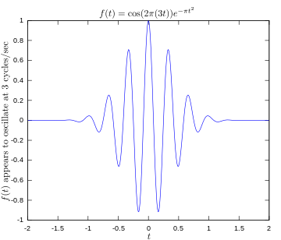
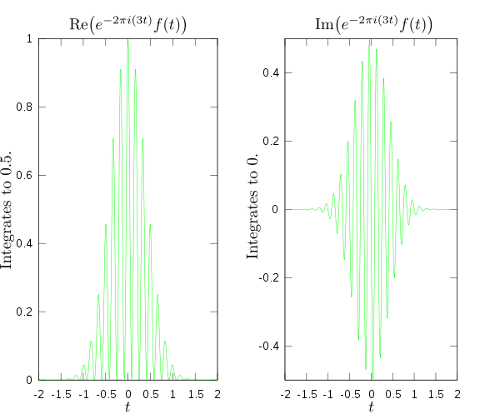
Filters - Convolution
What we are actually doing is a convolution
(Fast) Fourier Transform
In the regular image space, the convolution is a sum of products
In the Fourier domain, it becomes a product
Can be faster for filters with large kernels

Slide 33
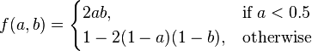
Combinations
Remember the lecture on Alpha Blending → Combination of source and destination pixels
Modes
Normal blend mode
Dissolve
Multiply
Screen
Overlay
Hard Light
Soft Light
Dodge and burn
Divide
Addition
Subtract
Difference
Darken Only
Lighten Only
Examples: http://docs.gimp.org/en/gimp-concepts-layer-modes.html

Slide 34
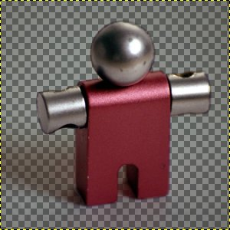
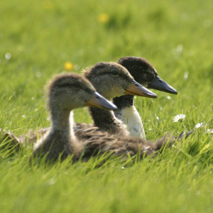
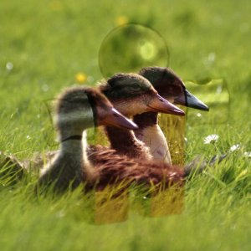
Example: Overlay blend mode
Base image light → Top image become lighter
Base image dark → Top image becomes darker
a is the base image color, b the top image color

Slide 35
Control of PCG algorithms
Level of detail of controls depends on target audience
E.g. artists on the game developer‘s team vs. Novice users
How many parameters to expose?
How many presets to provide?
How comfortable is the configuration process?
Provide visual editors
Generate examples of the generated set

Slide 36
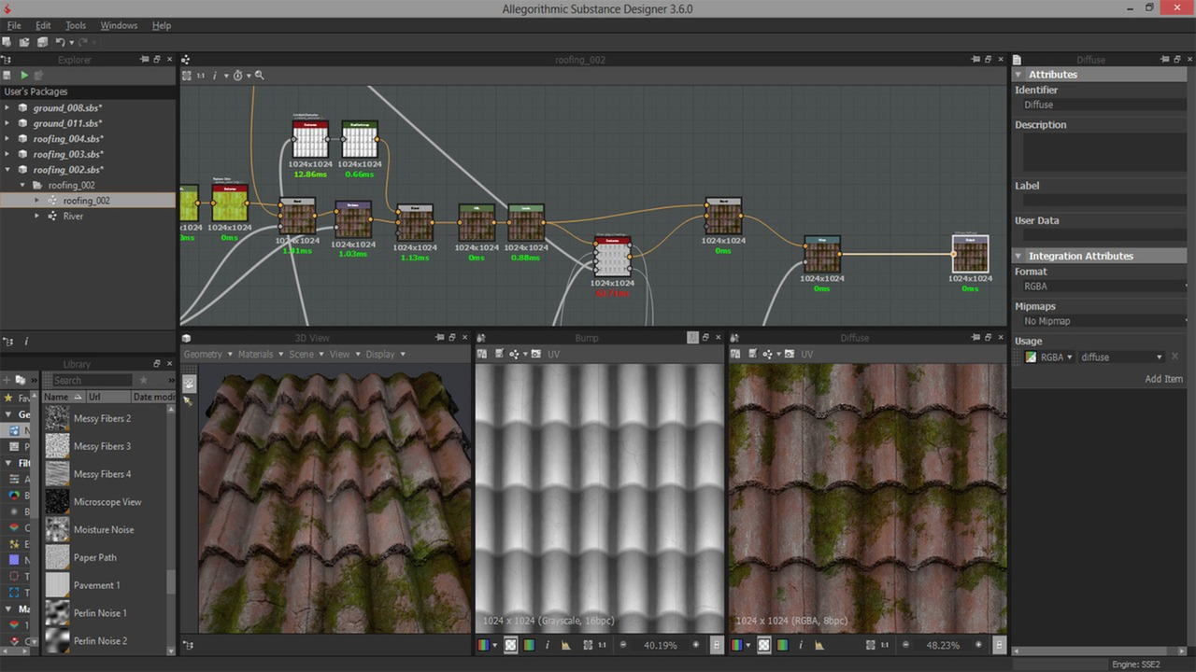
Visual Editors – Example: Substance Designer
http://www.allegorithmic.com/products/substance-designer
https://www.youtube.com/watch?v=XVk2inSEpvI#t=38

Slide 37
Voronoi Diagram
Take a set of points C1 to Cn, „sites“
Every point Ci defines a cell such that for each point P in the cell, no other point in C lies closer to P than Ci
Regular points lead to regular patterns
Random points lead to irregular patterns
Reptile skin
Parcels of land
...
(Dual to Delaunay Triangulation)

Slide 38
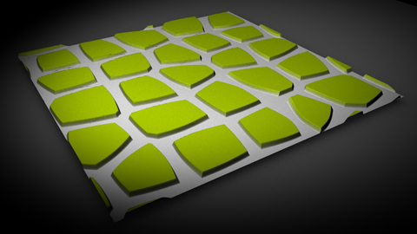
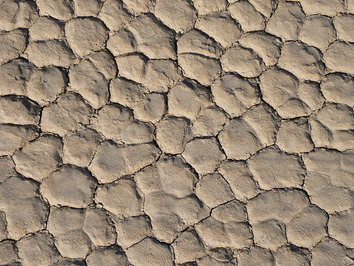
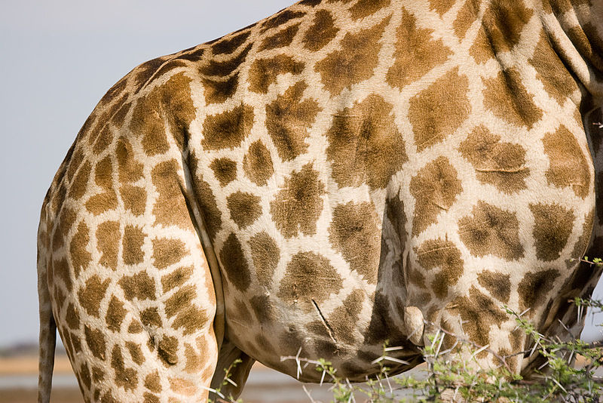
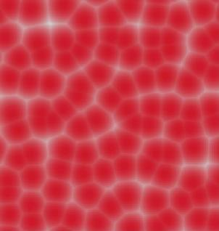
Voronoi Diagram – Texture examples
Cobblestone
Dry dirt
Giraffe skin
Blood cells

Slide 39
Fortune‘s Algorithm
Sweep line algorithm
We keep track of a sweep line
→ Everything on one side of the sweep line cannot be changed by the other side
Beach line
If we used only a sweep line, we could not be sure of the sweep line being „safe“

Slide 40
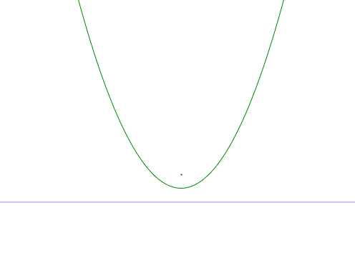
Beach Line
For a line and a point, the Voronoi diagram is a parabola
Every point inside and on the parabola is closer to the site than to the line

Slide 41
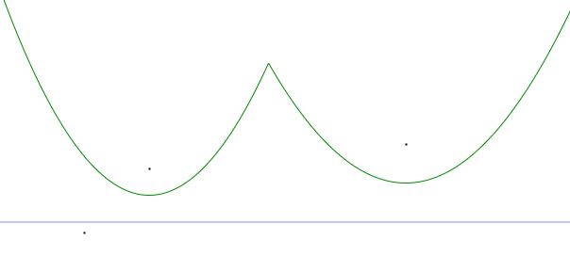
Beach Line
Several parabolas define a region in which all points are closer to the defining points than to the line
→We can compute the Voronoi Diagram for the region above the Beach line safely

Slide 42
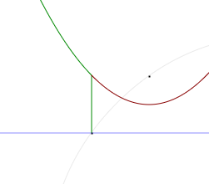
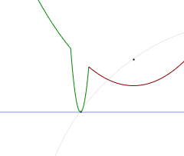
Point Events
Passing every new site creates a new parabola
The connecting points trace the edges of the Voronoi diagram as the sweep line moves down

Slide 43
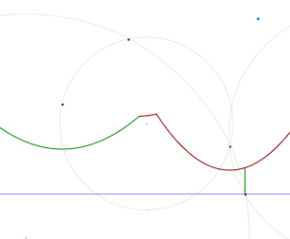
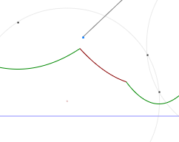
Circle events
Parabolas shrink
When a parabola disappears, a vertex of the diagram is found
This point is the center of a circle that is equidistant to the three sites defining the parabola and the line

Slide 44
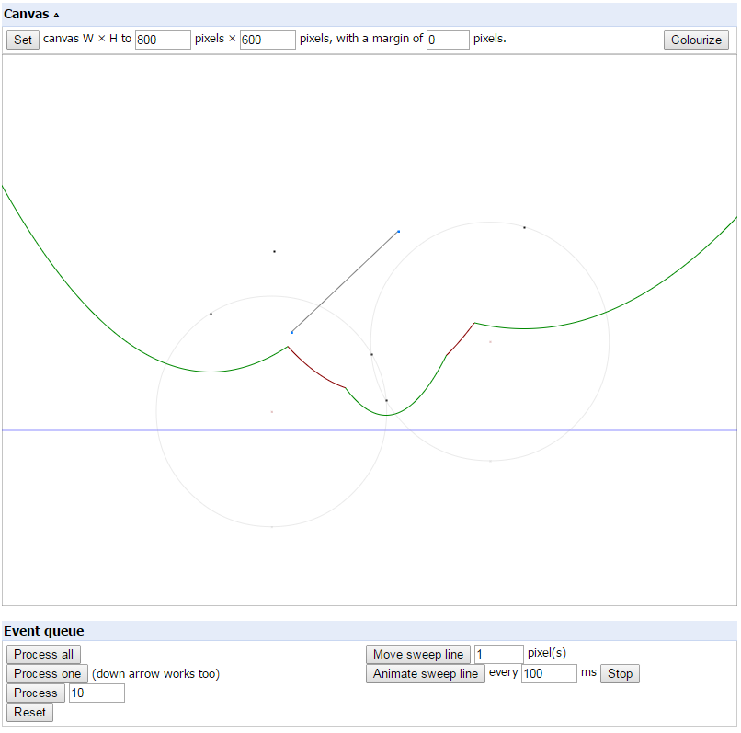
Examining Fortune’s algorithm
Javascript implementation at http://www.raymondhill.net/voronoi/rhill-voronoi.html

Slide 45
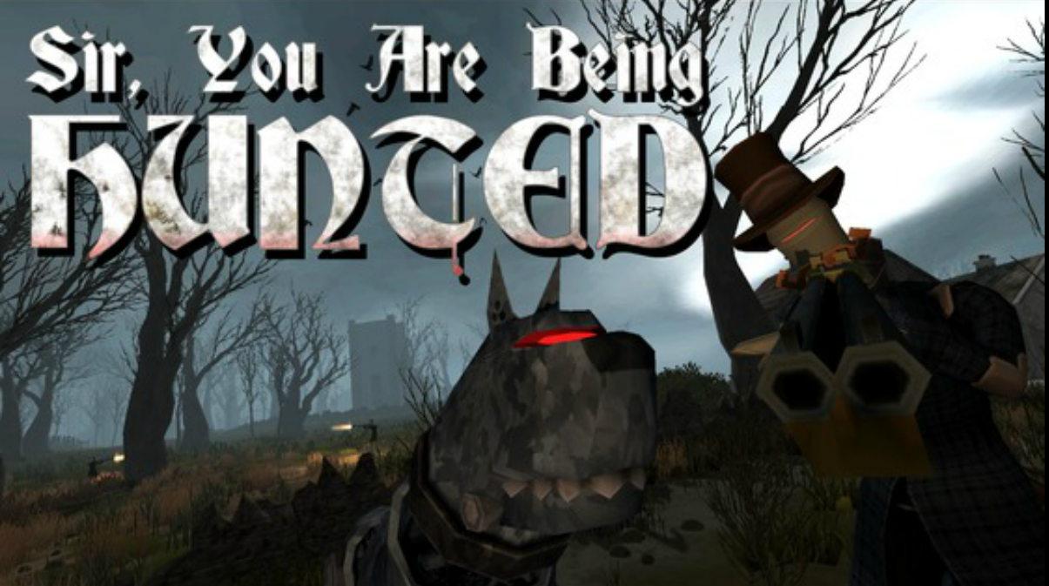
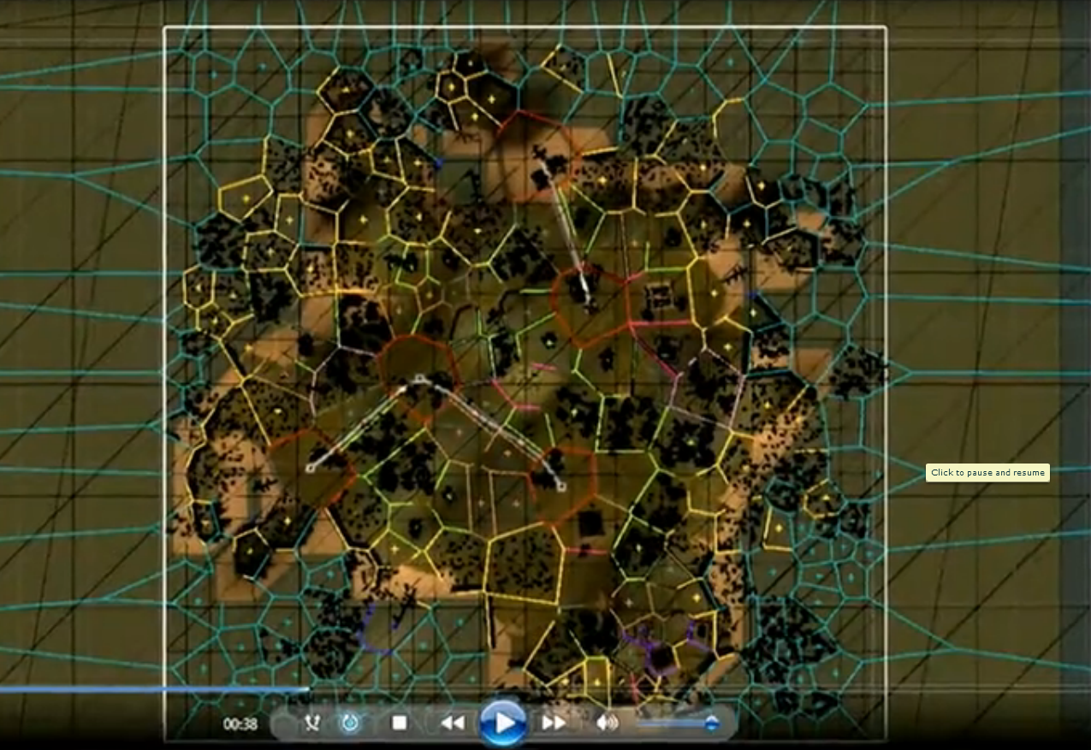
Voronoi Example 1 – Sir, you are being hunted
Build an “english countryside” look
Using Voronoi diagram as base

Slide 46
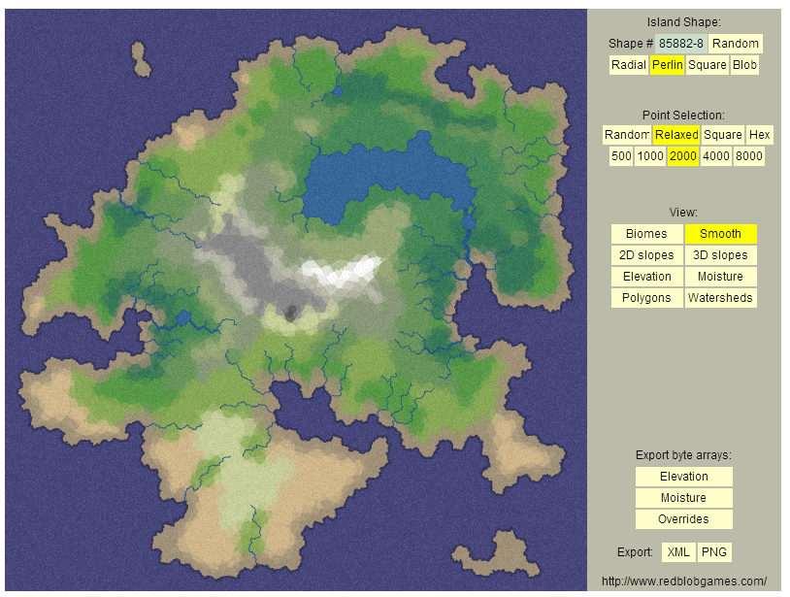
Voronoi Example 2 – Mapgen, Amit Patel
http://www-cs-students.stanford.edu/~amitp/game-programming/polygon-map-generation/demo.html

Slide 47

Simplex Noise
Random pixels
No continuity
If we interpreted it as a 2-dimensional function (heightmap), it would not work
Semi-Random Noise
Cloud-like look
Continuous
Works well as a heightmap

Slide 48
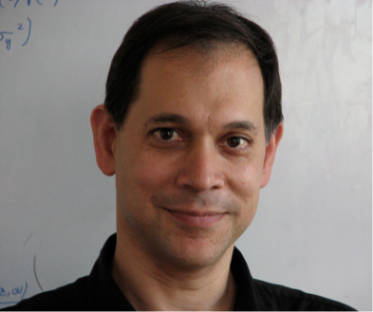
Perlin Noise, Simplex Noise
Perlin Noise
Developed by Ken Perlin in 1982 for Tron
Won an Oscar in 1997
Omnipresent noise generation function
Simplex Noise
Suggested by Perlin in 2001 as a succesor to the previous noise function
Better properties
Scales better to higher dimensions

Slide 49
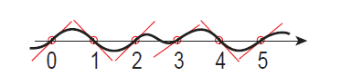
Perlin Noise
Gradient-based noise
Determine for each integer value
Function value 0
Pseudo-random gradient

Slide 50
Perlin Noise
For a given point x (2D), the result is computed by blending
The value of the previous gradient extrapolated to point x
The value of the next gradient extrapolated to point x

Slide 51

Perlin Noise
Blending function
Originally f(t) = 3t^2 – 2t^3
Later f(t) = 6t^5 – 15t^4 + 10t^3
Purpose
This way, the noise is also continuous at the integer positions

Slide 52

Perlin Noise (2D)
For x, y, the value is interpolated between the closest integer points such that i < x < i+1, j < y < j+1
Find the unweighted contributions by using the dot product

Slide 53
Perlin Noise – Dot product
Can be seen better in 1D
Gradient is the slope of the function
Vector towards the evaluated point is the x-Value
In this case, the dot product becomes slope * x

Slide 54
Gradients, Computation
Choose 8-16 gradients from the unit circle
Generate two random numbers (x and y)
Normalize the vector
To make the process repeatable
Save an array (e.g. n = 256 values) that contains a permutation of the first n integers → perm[]
Save the gradients in an array grad[][]
Look up using int i00 = perm[X + perm[Y] % numGradients]

Slide 55


Gradients, Computation
Use the dot product to calculate the contribution of a gradient to the sample
Gradients are defined at the grid points
Use vectors from grid points pointing to (x, y)
Interpolate in x-direction (2 rows)
Interpolate in y-direction

Slide 56
Using Perlin Noise
Normalize the noise
Divide x by width and y by height
Frequency
Noise = perlin(xnormalized * frequency, ynormalized * frequency)
Amplitude
Noise = perlin(x, y) * amplitude
Bring into range [0, 1]
Noise is in [-1, 1]
→ Add 1, Divide by 2

Slide 57



Using Perlin Noise

Slide 58

Using Perlin Noise
noise
sin( x + |noise(p)| + ½ |noise(2p)| + ...)
noise(p) + ½ noise(2p) + ¼ noise(4p) ...
|noise(p)| + ½ |noise(2p)| + ¼ |noise(4p)| ...

Slide 59

Literature
Julian Togelius
IT University of Copenhagen
http://julian.togelius.com/
Procedural Content Generation in Games - A textbook and an overview of current research
Available for free at http://pcgbook.com/
PCG Wiki
http://pcg.wikidot.com
Ebert, Musgrave, Peacheay, Perlin, Worley:
Texturing & Modeling – A procedural approach

Slide 60

Vegetation
One of the oldest fields of procedural content generation in computer graphics
Very much info available at : http://algorithmicbotany.org/
Well suited for generation
Based on natural processes
Complexity makes the shapes look realistic
Can be found be examining how nature handles growth

Slide 61

L-Systems
Prucinciewyz Lindenmayer
Book „The algorithmic beauty of plants“ is available for free at virtualbotany
L-System
Non-deterministic formal grammar
Follows the rules of growth
Two growth processes
Winter: Pruning of excess sprouts
Spring: Creation of new sprouts
Sprouts become branches over time

Slide 62
L-System
G = (V, ω, P)
V (the alphabet) is a set of symbols containing elements that can be replaced (variables)
ω (start, axiom or initiator) is a string of symbols from V defining the initial state of the system
P is a set of production rules or productions defining the way variables can be replaced with combinations of constants and other variables.
A production consists of two strings, the predecessor and the successor. For any symbol A in V which does not appear on the left hand side of a production in P, the identity production A → A is assumed; these symbols are called constants or terminals.

Slide 63

L-System Example
Example: Fractal plant
variables: X F
constants: + − [ ]
start: X
Rules: (X → F-[[X]+X]+F[+FX]-X), (F → FF)
angle: 25°
F: "draw forward“
-: "turn left 25°“
+: "turn right 25°“
X: Intermediate Symbol
[ push position and angle
] pop position and angle

Slide 64
L-Systems
The resulting string is transformed into a mesh using a turtle algorithm
Small branches and foliage as billboards
Placement as determined by the system
Movement of the tree
Simple animation where the top of the tree sways more than the bottom
More physically correct: Simulate individual branches

Slide 65
Programming – Virtual classes, interfaces
So far, we have seldomly used virtual classes or inheritance
Overhead that this incurs
Virtual function table
Inlining not possible
Advantages
Better coding style
Build interfaces that other programmers can implement

Slide 66
Virtual functions in C++
Making the function
Add the virtual keyword to a function declaration
class A {
virtual void foo(int a);
}
Deriving from the class
Usually use class B: public A { };
Overriding methods
Provide the function in the inheriting class
class B: public A {
virtual void foo(int a);
}

Slide 67
Casting
Implicit
A* a;
B b;
a = &b;
Explicit
A* a;
B b;
a = (A*) &b;

Slide 68
Casting
dynamic_cast (requires run-time type information RTTI)
dynamic_cast<type>(pointer);
Returns nullptr if the cast is not possible
Can upcast and downcast
static_cast
static_cast<type>(pointer);
No type checks
reinterpret_cast
All combinations
Also cast integers to pointers

Slide 69
Abstract classes/functions
No dedicated keyword
virtual void abstract_function() = 0
Build interfaces from these

Slide 70
Constructors, Virtual destructors
Constructors
No-parameter constructor called automatically
Constructors with parameters must be called in the initialization list
class Sub : public Base
{
Sub(int x, int y): Base(x), member(y)
{
}
Type member;
};
Virtual destructors
Need to be virtual to be callable by a pointer to the base class

Slide 71

Multiple Inheritance
Use with caution
Can make sense if you know what you are doing
E.g. re-produce interfaces from other programming languages

Slide 72
Exercise 9
1.1 Separating Axes test
The test did not really depend on this axis
1.2 Collision Basis
Use the formulae from the slide
One border case: What if the collision normal was parallel to the chosen axis?
1.3 Depends on your theoretical solution
Theoretical Task
We will provide links/descriptions to the tests you found in the solution

Slide 73
Separating Axes Test
B
B
P
P
A
C
A
C

Slide 74
Exercise 10 – Procedural Content Generation
Build a texture generator of your choice
If you cannot think of one, you can use the ones from the lecture
1.1 Implement Perlin Noise
1.2 Implement Gaussian Blur
1.3 Implement the „Overlay“ combine mode
1.4 Create your own network

Slide 75

Exercise 10

Slide 76

Exercise 10

Slide 77

Exercise 10

Slide 78

Exercise 10

Slide 79

Exercise 10

Slide 80
Exercise 10 – Theoretical Exercises
2.1 Voronoi Diagram
Imagine a set of points (e.g. cities in an RTS game)
How can you visualize the „border“ of the area controlled by the cities by making use of a Voronoi Diagram?
2.2 Analyze an edge detect kernel
2.3 Analye the properties of the Gaussian distribution

Slide 81

Merry Christmas ☺

Slide 82




Questions & Contact
RK
game-technology@kom.tu-darmstadt.de

